Slide 1
2016 Region H Initially Prepared Regional Water Plan
Water Efficiency Network
Conroe, TX
24 September 2015

Slide 2
Growth of Texas

Slide 3
Growth of Texas
THIRST
1 ft.
325,851 gallons
1 ac.

Slide 4
The Cheap Water is Behind Us

Slide 5
Limits of Conventional Wisdom

Slide 6
Water Planning in Texas
Provide water project funding
Prepare state water plans

Slide 7
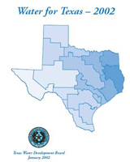
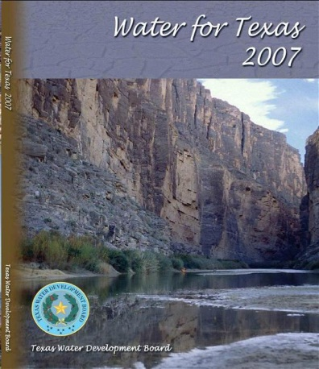
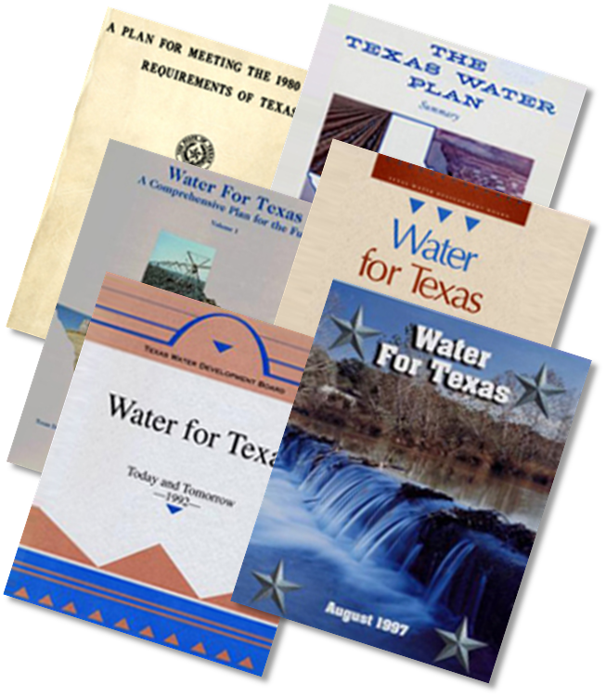
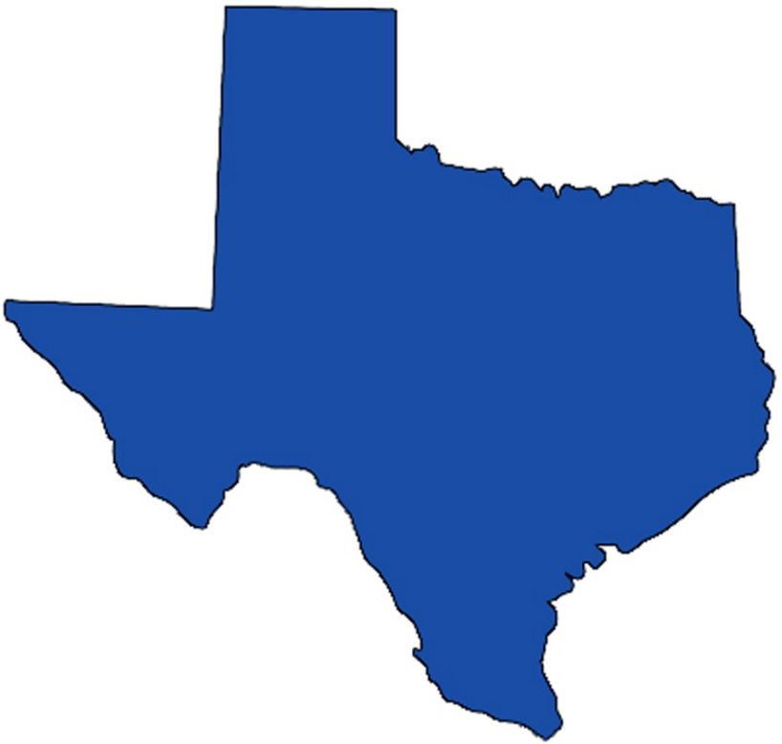
Water Planning in Texas

Slide 8
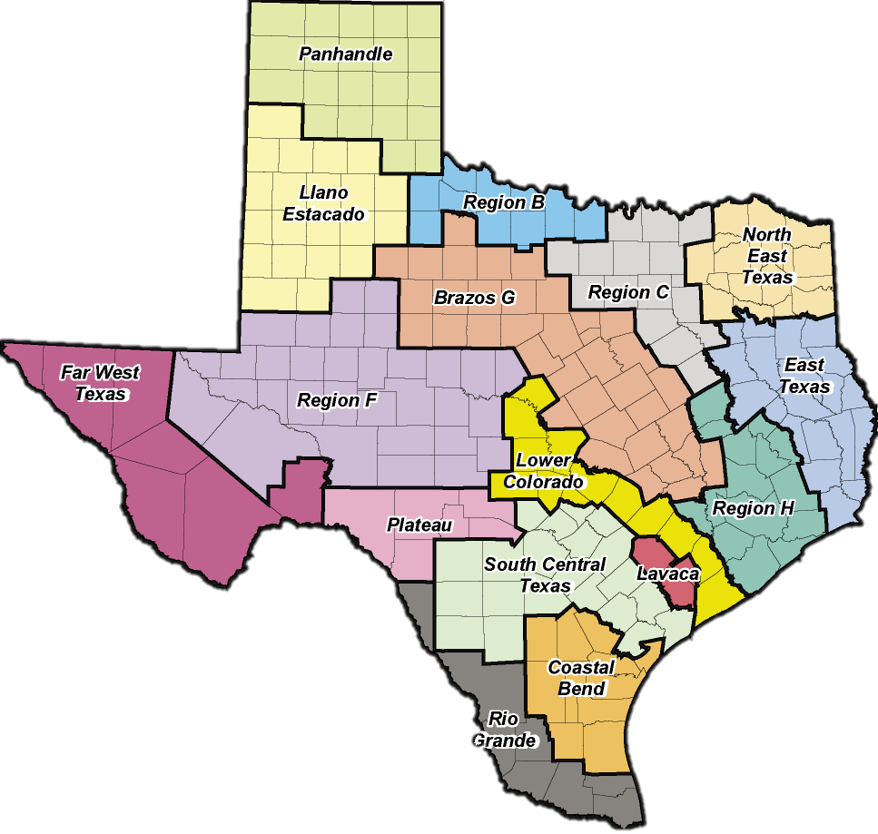
Regional Water Plans
16 regions based on natural and political boundaries
Volunteer planning groups of diverse interests
Five-year cycle
2001
2006
2011
2016
Regional Water Plans (RWPs) compile into State Water Plan (SWP)

Slide 9
The Planning Process
Strategies How can we get more water?
Demands How much water do we need?
Identify
Needs
Select
and Recommend
WMS
Supplies How much water do we have?
Initially Prepared Plan Public review and comment
Final Plan What do we recommend?

Slide 10
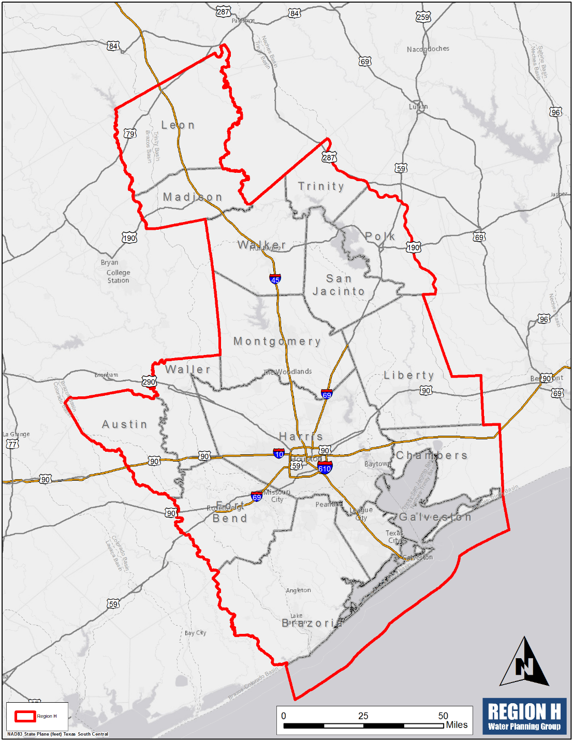
Region H
About Region H
Extends over 15 counties
26 Planning Group members
Agriculture
Electric Utilities
Groundwater
Municipalities
River Authorities
Water Districts
Guided by public input and involvement
Counties
Environment
Industries
Public
Small Business
Water Utilities

Slide 11
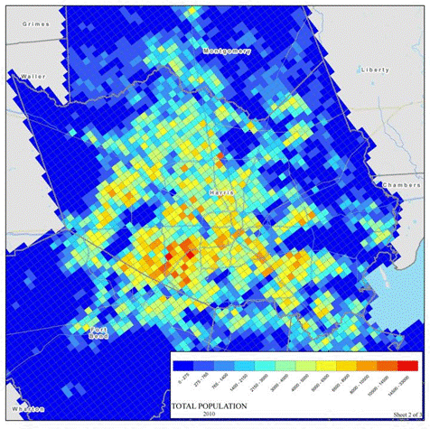
Region H 2016 Regional Water Plan
Population and Water Demands

Slide 12
Region H 2016 Regional Water Plan
Population and Water Demands

Slide 13
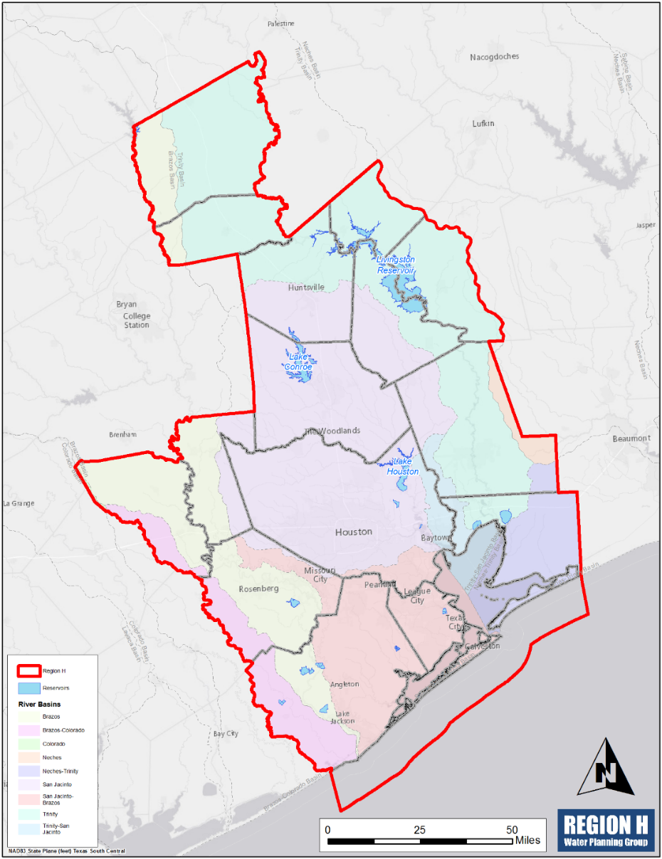
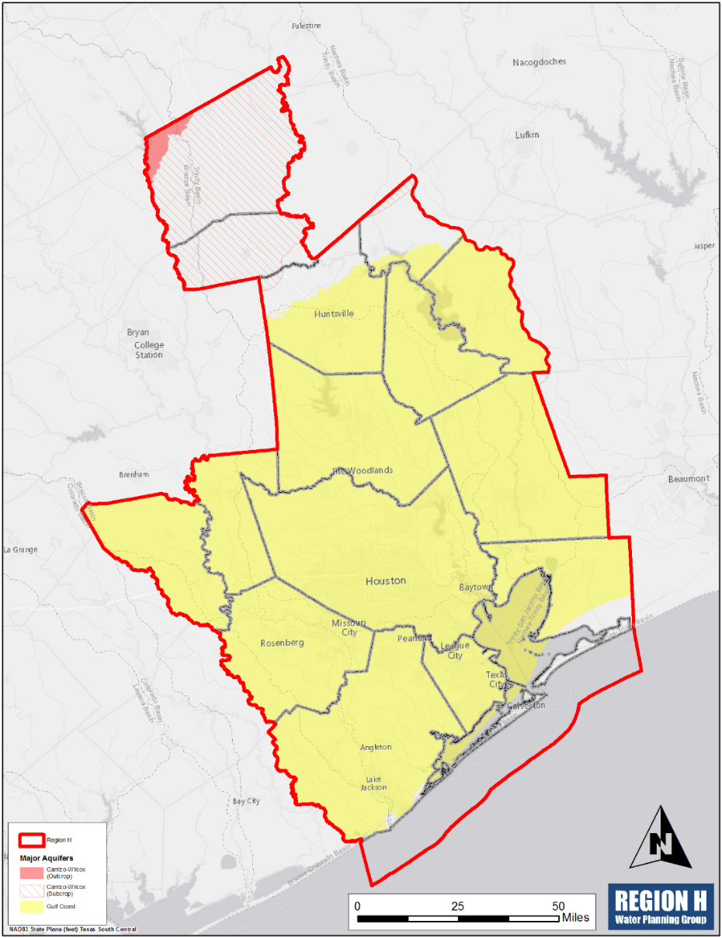
Region H 2016 Regional Water Plan
Available Water Supplies
Surface Water
Three river basins
Three major reservoirs
Groundwater
Two major aquifers
Four minor aquifers
Other supplies
Reuse
Local

Slide 14
Region H 2016 Regional Water Plan
Available Water Supplies
Surface Water
Drought-of-record
Texas Commission on Environmental Quality (TCEQ) Water Availability Model (WAM)
Groundwater
Groundwater Management Area Process
GMAs 11, 12, and 14
Reuse
Direct and indirect sources

Slide 15
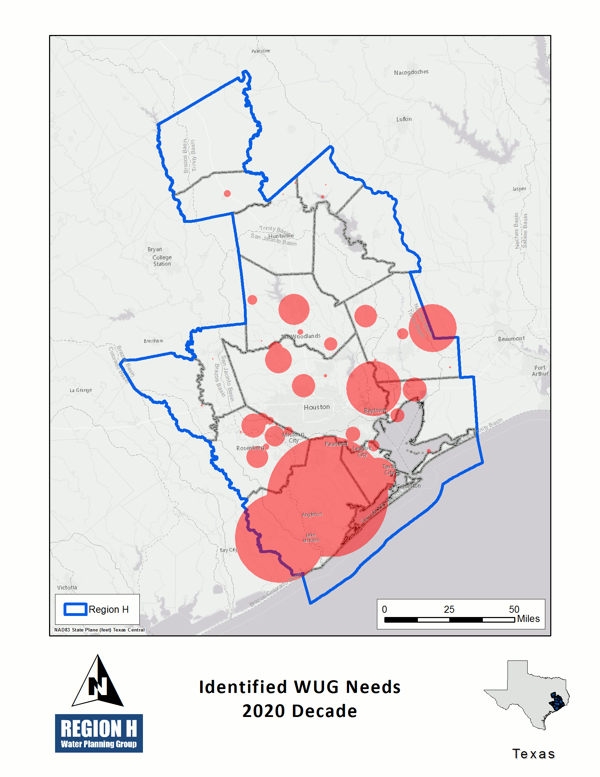
Region H 2016 Regional Water Plan
Needs (Shortages)

Slide 16
Region H 2016 Regional Water Plan
Significant Reduction in Needs
Reduced non-municipal demands
Primarily irrigation
Implementation of projects
Groundwater Reduction Plans
Transmission
Treatment

Slide 17
Region H 2016 Regional Water Plan
Water Management Strategies and Projects
70 Water Management Strategies (WMS)
Missouri City Groundwater Reduction Plan
New/Expanded Contract with BRA
705 Projects
Luce Bayou Transfer
Allens Creek Reservoir
Key Projects by category

Slide 18
Region H 2016 Regional Water Plan
Conservation Projects
Industrial
Irrigation
Municipal
Baseline
Advanced
Water Loss Reduction

Slide 19
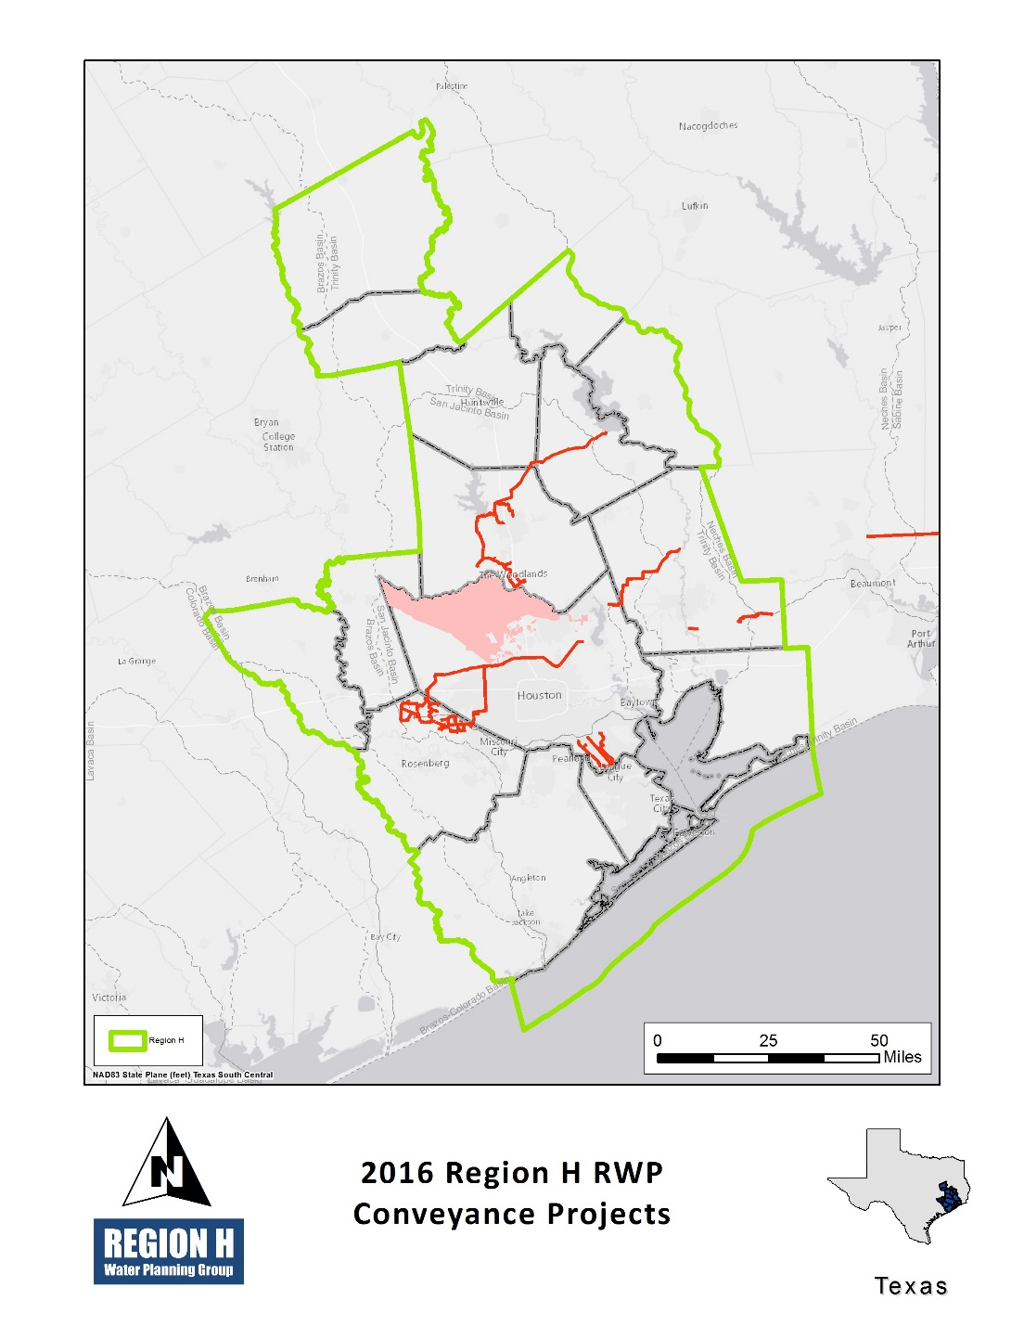
Region H 2016 Regional Water Plan
Conveyance Projects
GRP Transmission and Distribution
CHCRWA
NFBWA
NHCRWA
WHCRWA
East Texas Transfer
Lake Livingston to SJRA Transfer
Luce Bayou Transfer
Old Galveston Road Transmission

Slide 20
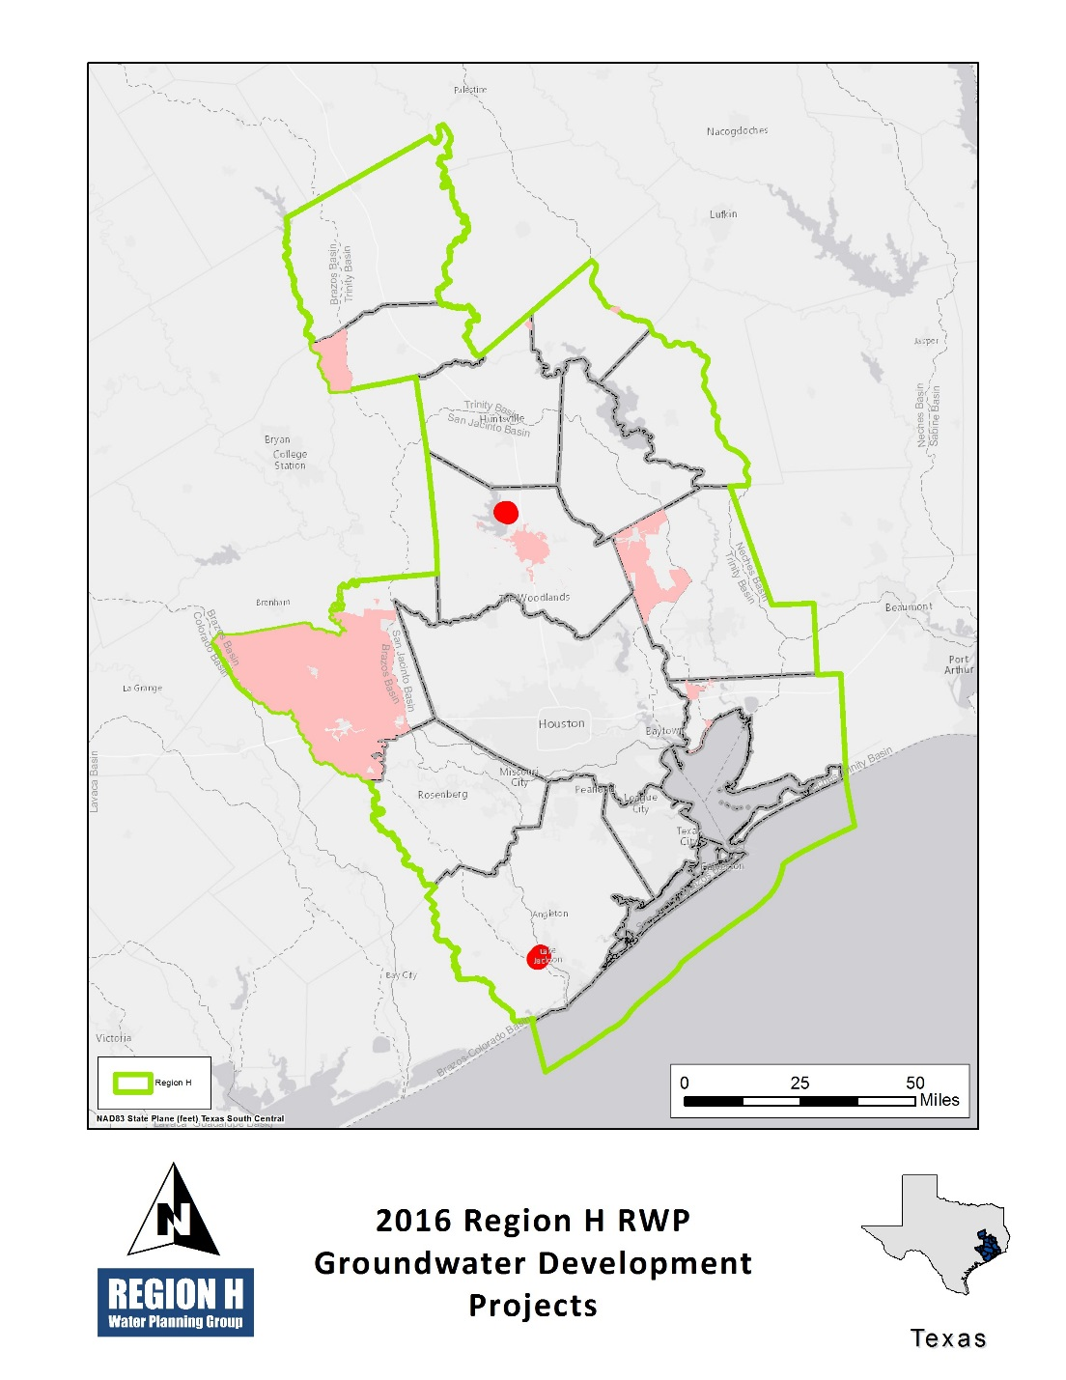
Region H 2016 Regional Water Plan
Groundwater Development Projects
Brackish Groundwater Supplies
General
BWA
City of Conroe
Expanded Use of Groundwater
Groveton Groundwater Expansion
SJRA Catahoula Aquifer Supplies

Slide 21
Region H 2016 Regional Water Plan
Groundwater Reduction Plans
CHCRWA
City of Houston
City of Missouri City
City of Richmond
City of Rosenberg
City of Sugar Land
Fort Bend County MUD 25
Fort Bend County WCID 2
NFBWA
NHCRWA
Panorama Village and Shenandoah
Porter SUD
River Plantation
SJRA
WHCRWA

Slide 22
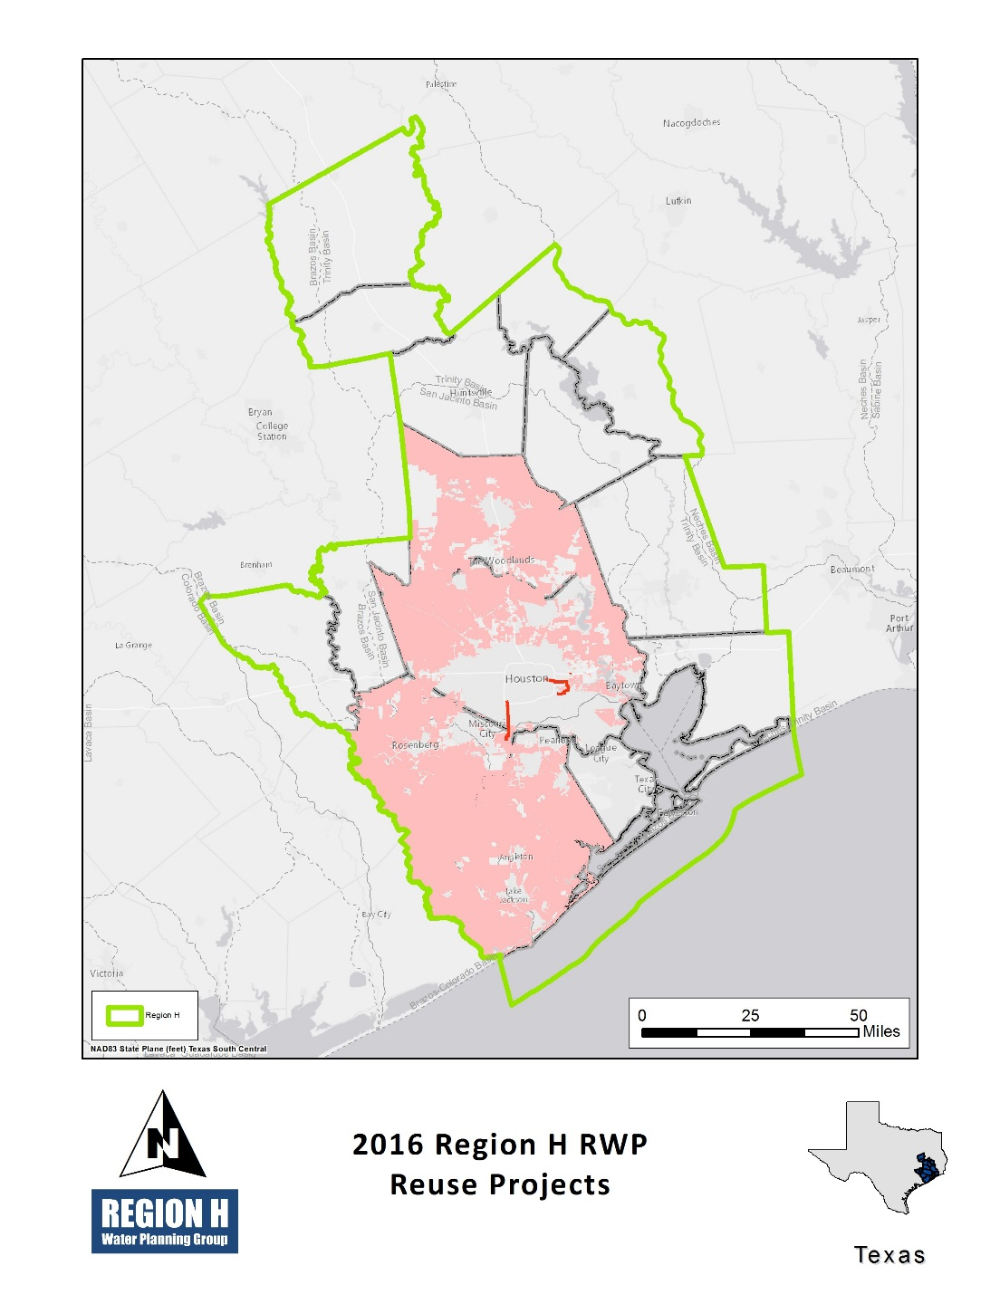
Region H 2016 Regional Water Plan
Reuse Projects
Indirect
City of Conroe
City of Houston
City of Pearland
GCWA Reclaimed Water from Houston
Montgomery County MUDs #8 and #9
Regional Return Flows
SJRA City of Conroe
Direct
Wastewater Reclamation for Municipal Irrigation

Slide 23
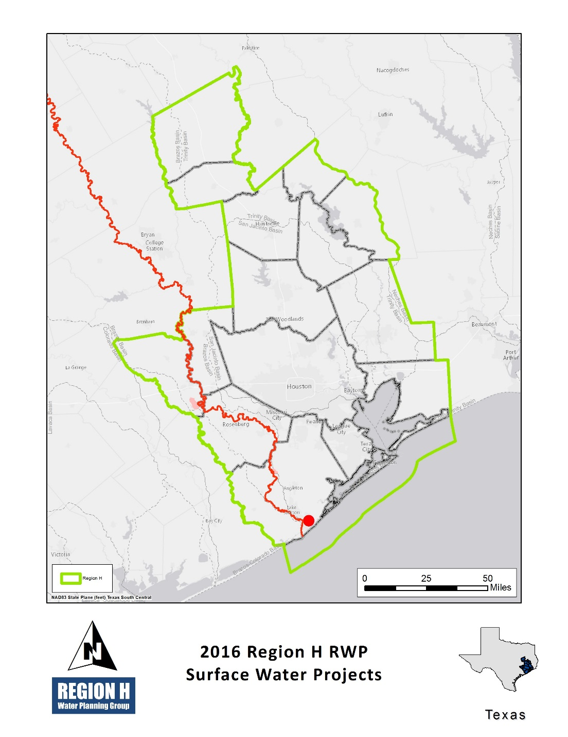
Region H 2016 Regional Water Plan
Surface Water Projects
Allens Creek Reservoir
BRA System Operation Permit
Dow Expansion to Harris Reservoir
Freeport Seawater Desalination

Slide 24
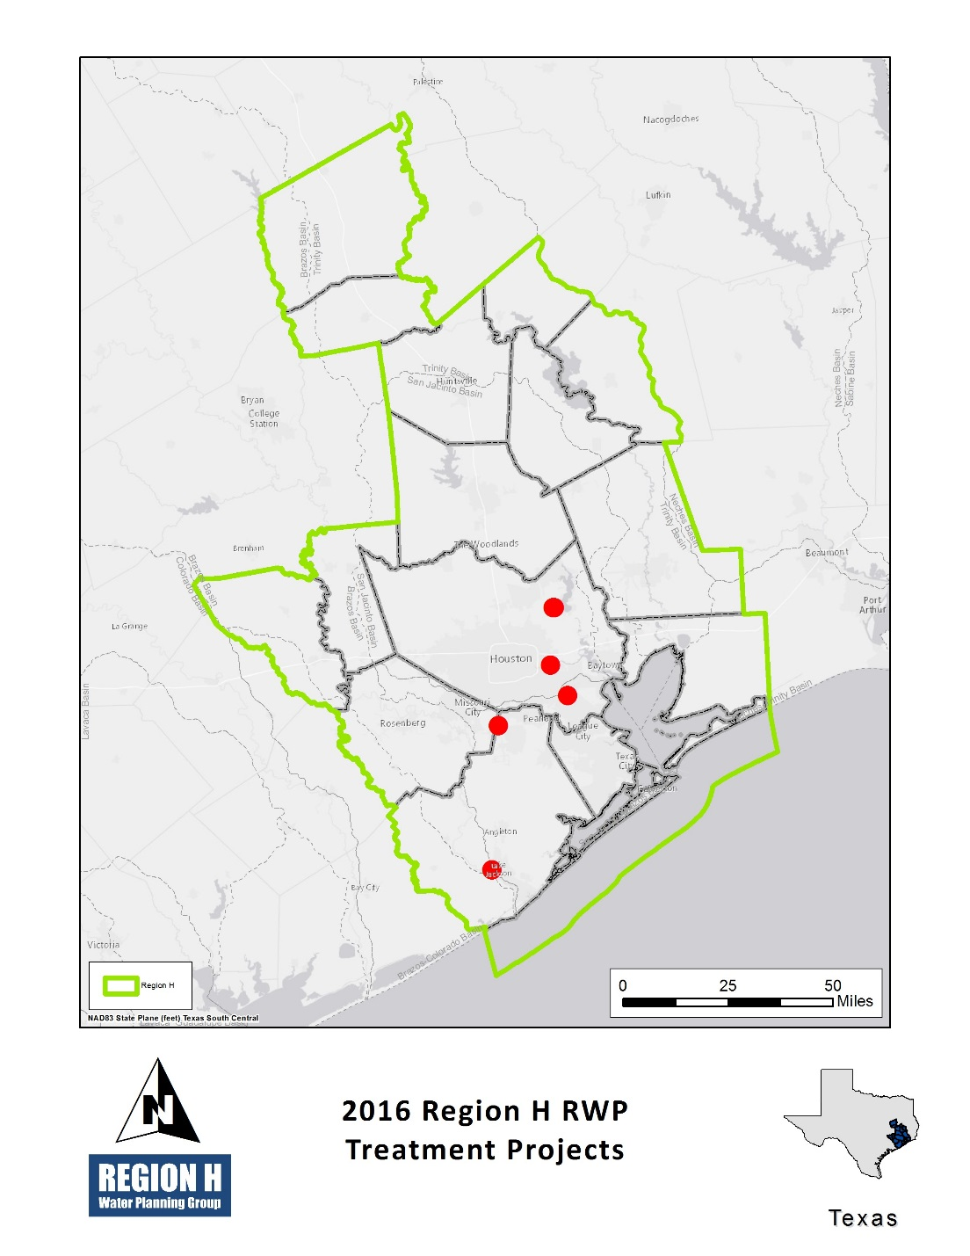
Region H 2016 Regional Water Plan
Treatment Projects
BWA Treatment Plant Expansion
City of Houston Treatment Expansion
CLCND West Chambers County System
Houston NEWPP Expansion
Pearland Surface Water Treatment Plant

Slide 25
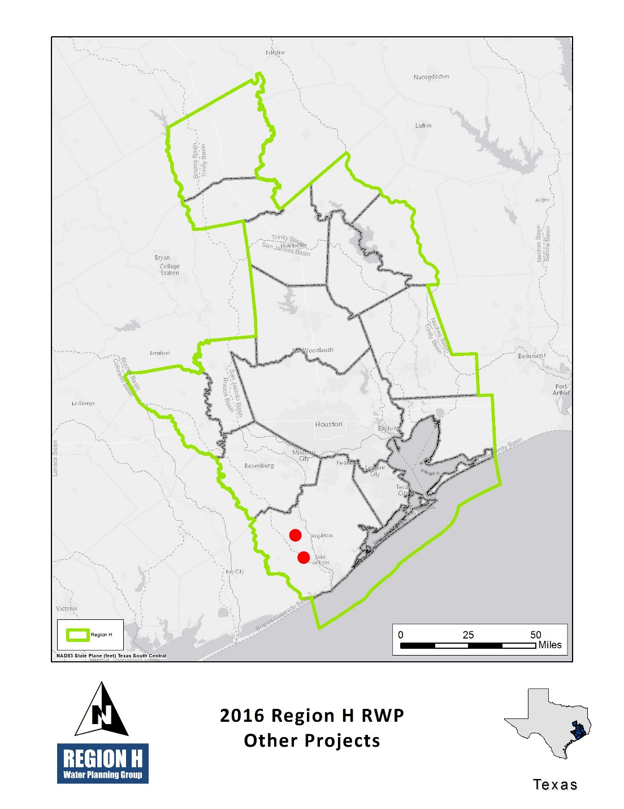
Region H 2016 Regional Water Plan
Other Projects
Brazos Saltwater Barrier

Slide 26
Region H 2016 Regional Water Plan
Project Financing Mechanisms
State Water Implementation Fund for Texas (SWIFT)
Water Infrastructure Fund (WIF)
Texas Water Development Fund (D Fund)
Drinking Water State Revolving Fund (DWSRF)

Slide 27
Region H 2016 Regional Water Plan
Public Involvement
Why Get Involved?
How to Get Involved
Build upon local planning efforts
Enhanced tools from region, state
Identify gaps in long-term planning
Finding regional opportunities
State funding
Identify regional need for infrastructure
Eligible for State programs
TWDB-funded
No cost to participate
Public process by design
Regional Planning Group meetings
Outreach to stakeholders
Survey (population and demand projections, supplies, projects)
Directed correspondence
Public comment period
Between IPP and Final Plan submittals

Slide 28
IPP Public Process
Initially Prepared Plan Available
http://www.regionhwater.org
Public Hearings
Thursday, June 18 @ 6:00 PM Huntsville Walker County Storm Shelter
Tuesday, June 23 @ 6:00 PM Houston Houston-Galveston Area Council
Wednesday, July 1 @ 10:00 AM Conroe San Jacinto River Authority

Slide 29
Conservation: Striking a Balance
Conservation
Reservoirs
Groundwater
Reuse
Transmission
Treatment
Desalination
GRPs

Slide 30
Conservation: Benefits vs Obstacles
Avoidance/ Delay of Major Infrastructure
Lack of Information
Amplified Data Gap at Regional Level
Funding Opportunities
RWPGs Cannot Enforce Conservation
Scalable Approach
Significant Results Require Many Stakeholders
YOU ARE HERE
Continuous Process
Low Cost Strategy
SWEET VICTORY!
Most Rates Not Build for Robust Conservation

Slide 31
Conservation: Difficulties with a Regional Approach
Note: This is the fine print. The print is fine. I doubt you will find a finer print. If you want to read this then fine with me.

Slide 32
Conservation: What You See, What You Don’t
Irrigation
Municipal
Industrial
Approaches to on-farm methods and reduction in conveyance loss.
Water loss reduction methods and advanced conservation approaches.
Sector-wide reductions based on long-term trends in water use.
Current practices in use throughout the region, motivated by economic efficiency.
Unit demand reduction based on projected plumbing code requirements and the adoption of efficient appliances.
Assumed efficiency factors incorporated into the original projections of long-term demand.

Slide 33
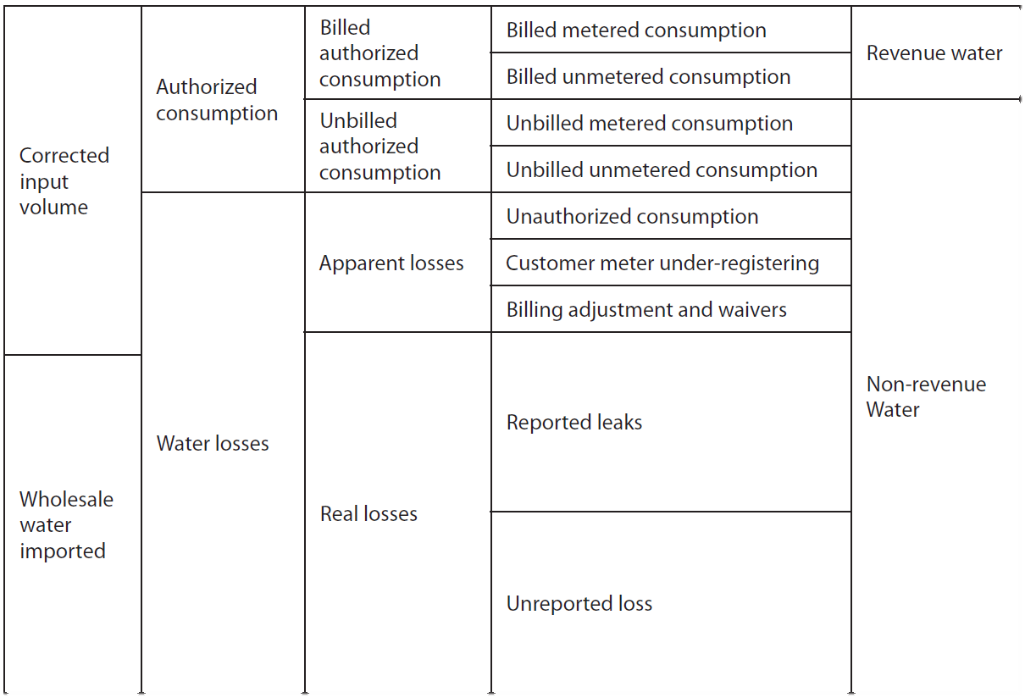
Conservation: Municipal Conservation in the 2016 RWP
Water Loss Reduction
Target systems with >10% losses
1% reduction annually
Target of 10% maximum loss

Slide 34
Conservation: Municipal Conservation in the 2016 RWP
Advanced Conservation
Goldwater Study
Focus on meeting 2011 RWP goals in 5 counties
2-year program with ongoing objectives
Direct interaction with participating utilities
Various recommended practices
Landscape controllers, audits, and surveys
Efficient commercial fixtures
Toilet rebates

Slide 35
Conservation: Irrigation Conservation in the 2016 RWP
On-Farm Practices
Land leveling
Conveyance Techniques
Canal improvements
Strategy Analysis
Identification of rice acreage
Identification of already-improved acreage

Slide 36
Conservation: Industrial Conservation in the 2016 RWP

Slide 37
Conservation: Comprehensive Conservation in 2016 RWP

Slide 38
Conservation: A Continuous Planning Process
Track Water Use
Recommend Demands
Develop RWP

Slide 39
Conservation: Opportunities for Conservation Funding
City of Bedford
Distribution system conservation program
$90 million
State Water Implementation Fund for Texas (SWIFT)
$2 billion to implement the state water plan
20% Designated for Reuse and Water Conservation
10% Designated for Agricultural Conservation
City of Fort Worth
Meter Upgrade and Replacement Program (Smart Meters, Leak Detection)
$76 million

Slide 40
2016 Region H Initially Prepared Regional Water Plan
Water Efficiency Network
Conroe, TX
24 September 2015

